Slide 1
Planning and Scheduling for Operational Astronomical Missions
Mark Giuliano
Space Telescope Science Institute

Slide 2
What I do
I work for the Space Telescope Science Institute (STSCI) which is responsible for operating the Hubble Space Telescope
STScI is responsible for all phases of science operations including:
    Selecting science observations based on proposals from the astronomical community;
    Planning and scheduling of science observations and engineering activities;
    Archiving, calibration, and analysis of data obtained from HST observations.
    Managing the research grants associated with observing programs
We are currently developing the same capabilities for the James Webb Space Telescope

Slide 3
Goals of Today’s talk
To give you a basic understanding of the astronomical planning and scheduling domain
  Features of astronomical missions
  Astronomical planning and scheduling constraints
  Use cases for planning and scheduling
All given with an operational perspective
Offer general advice on what makes a successful Operational planning and scheduling application

Slide 4
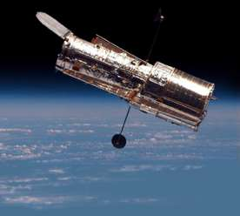
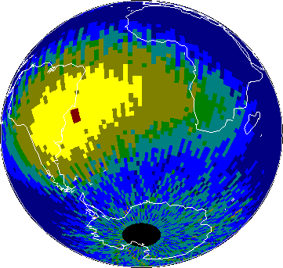

HST Mission
HST is a general purpose space observatory
  Near-infrared, visible, and ultraviolet observing
In low earth orbit 600 km above earth
Orbits the earth every 96 minutes = 15 orbits per day
  The earth blocks target visibility ~40 minutes in each orbit
Target
Sun

Slide 5

James Webb Telescope
Launch 2013 2018
Infrared sensors - to see the earliest star formation.
L2 orbit 1.5 million Km from Earth.
6.2 meter mirror
Tennis court sized sun shield to protect science instruments.

Slide 6
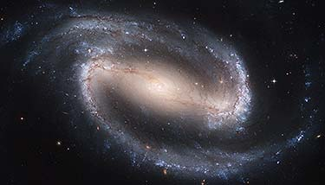
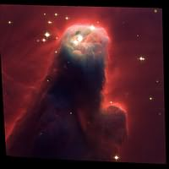
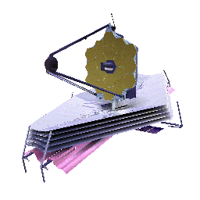

Cannot observe
Can Observe
Cannot
Observe
JWST observing cone varies over the year with most targets getting two ~30 day windows

Slide 7
Mission Characteristics
Observatory Orbit
  Low earth orbit (earth occultation)
  Farther out orbits (L2)
Types of science instruments
  Duration of exposing activities
  Instrument campaigns when the cost of switching between instruments is high
  Calibration and maintenance activities
Observation preparation and planning cycle
  Yearly, monthly, on demand
Mission Duration
Customers
  Astronomers (in house or external), general public, students

Slide 8
Physical vs Astronomer Constraints
Physical constraints are those required by the capabilities and tolerances of the observatory
    Sun avoidance, Earth avoidance, Moon avoidance, Guide stars
Astronomer constraints are additional specifications required to achieve the desired science goals
  Time linkages between observations
    Observation 1 after Observation 2 by 10-20 days
  Phase constraints to sample a target with a periodic effect
  Between windows to capture single events or to coordinate with other observatories

Slide 9
Absolute vs Relative Constraints
Absolute constraints apply to a single observation
  Include both physical and observer specified constraints
Relative constraints link observations together
  All of these are observer specified
  Timing constraints:
    Group-within, sequence-within, after-by

Slide 10
The constraint domain for space telescopes typically consists of time and space craft roll
  Telescopes can roll about their bore sight
  Roll is limited by the need to keep parts of the scope normal to the sun
    Thermal and energy concerns
At any time JWST can roll +/- five degrees from the normal position where the sun screen is normal to the sun.

Slide 11
Space Craft Roll Constraints
Observers may require observations with the spacecraft at a certain roll
  E.g. to handle non circular apertures or to avoid bad pixels in an aperture
Observers may require observations to be linked via space craft roll
  E.g. same roll observation 1 and observation 2
Roll constraints induce time constraints
Other physical and observer constraints induce roll constraints
  Guide stars are typically only available within a given roll range
Need to model both the legal times an observation can schedule as well as the legal rolls available over time

Slide 12
Constraint Propagation
Want to be able to propagate constraints so that:
  legal scheduling windows can be made available to observers and to the planning software.
Constraints are beyond simple temporal networks
    Absolute constraints can have multiple intervals
      E.g. the sun constraint can be satisfied in different intervals over the year
    Group within make the problem NP complete
Need to propagate roll constraints as well as time
  The wrap around nature of roll makes roll links equivalent to group within constraints
We approximate full propagation

Slide 13
Constraint Propagation Example
Obs 1
Obs 2
Time: 0 5 10 15 20 25 30 35 40
These plots show intervals that are good for scheduling two different observations.
Now suppose that Obs 2 is after Obs 1 by 5-12 time units
Obs 1
Obs 2

Slide 14
A Tricky Case With Roll Constraints
Obs 1
10
20
Legal roll
Obs 2
20
10
Time: 0 5 10 15 20 25 30 35 40
Now suppose that we have the following link constraints:
  Obs 2 after Obs 1 by 10 days
  Same Roll Obs 1 and Obs 2
If we propagate the link constraints independently the above intervals seem suitable
However, there are no times where all the constraints are satisfied
Situations like these complicate determining observation suitability

Slide 15
HST/JWST Observing Cycle
Observations are executed in a yearly cycle
  Astronomers submit proposals to STScI
  Time Allocation Committee approves time to observations based on scientific merit
  Astronomers prepare detailed observation program
    Plan observations
  In house staff plan and schedule observations
    Ingest all new proposals for the cycle in a Long range Plan
    Create short term schedules from the long range plan
  Astronomers analyze data and publish results

Slide 16
Planning and Scheduling
Two Step Approach
Long range planning
  Assigns observations for a cycle to 56 day long least commitment plan windows.
  Concerned with resource balancing, plan stability
Short term scheduling
  Creates week long second-by-second schedules using plan windows as input.
  Concerned with schedule efficiency
Year-based
Long Range Planning
(Assigns N week long
window for start
time)
Week-based
Short Term
Scheduling
(Assigns start time)

Slide 17
Planning and Scheduling Cont
Motivation:
  The precise orbit model for observatories are known only a few weeks in advance
    Uncertainties in the orbit prevent the creation of second-by-second schedules in advance
  Separation of concerns:
    Long range planning
      Resource balancing, Stability of plan
      Allows observers to know when to hire graduate students to reduce their data
    Short term scheduling
      Schedule efficiency
    Reduce the decision space in system.

Slide 18
Planning vs Scheduling
Most of what we do is scheduling and not planning
  Just assigning times with no action selection
Observation planning:
  Sequences of actions for individual observations are planned by observers to achieve science goals
  Use special purpose software
    Could this problem be put in PDL
Long range planning observations to windows
  Could be called long range scheduling
Short term scheduling observations to precise times
Will talk about observation planning and long range planning
  That is what I work on

Slide 19
Planning Observations
The TRANS software system proves a decision support tool for planning individual HST observations
  Takes input provided by astronomers and generates a detailed plan for executing the observation on HST
    Input: target pointing, instrument modes, filters, optional parameters, exposing durations
  This involves
    the creation of support activities - automatic Calibrations, buffer dumps (e.g. buffer dumps),
    Modeling of instrument overheads (e.g. filter moves),
    Grouping of activities into a hierarchy based on exposure pointing and engineering concerns.
    Packing exposures into orbits
  All down stream planning and scheduling systems use the plan as input

Slide 20
Example Output
What is the goal of the planner? To use a minimal
Number of orbits? Fill each orbit?

Slide 21
Example Output
Observer directed the system to use two orbits and
to expand the durations of selected exposures

Slide 22
Lessons Learned
The planning system originally made decisions as to how to place exposures into orbits
  Unclear as to what was being optimized
  Confused users
Switched to being a decision support tool
  Observers can specify how exposures map to orbits and which exposures should be expanded to fill orbits
By placing decisions with the user we increased user satisfaction with the tool

Slide 23
Long Range Planning
1. Calculating Constraint Window
Observation constraint windows are calculated from all physical and observer specified constraints, and denote the timeline of when the observation can be scheduled.
2. Generating Plan Windows (PW)
Using least commitment scheduler, SPIKE, observations are assigned plan windows, which are the preferred window for scheduling.
Plan windows are a subset of the constraint windows and are nominally 56 days long.
1
0
Feb
Mar
Apr
Jun
Jul
Aug
Sep
Nov
Plan Window
1
0
Feb
Mar
Apr
Jun
Jul
Aug
Sep
Nov

Slide 24
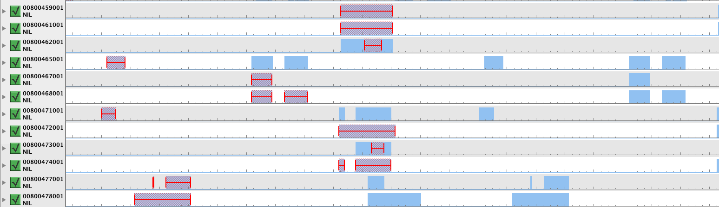
Plan Windows
The red bars give plan windows
The short term scheduler uses unexecuted observations with open plan windows to create its candidate list for a weekly schedule

Slide 25
Spike
Spike is a general toolkit for constraint based planning and scheduling developed for the Hubble Space Telescope by STScI.
Spike has evolved over the years with HST and other mission deployments into a robust software package which is easily adaptable for new missions
  long and short range astronomic planning and scheduling,
  ground and space based planning and scheduling
  Easily integrated with other ground systems components and operations concepts
Used for both HST and JWST long range planning

Slide 26
Spike Adaptability
What makes Spike easily adaptable:
Powerful and easy to adapt temporal constraint model
Architecture is modular and layered
Object oriented design
Large library of astronomical utilities

Slide 27
SPIKE Package Hierarchy
Notes:
----- Meeting Notes (6/2/11 15:11) -----
Simplify this, only show generic and HST and JWST.

Slide 28
A challenge For Long Range Planning
Cannot Directly Measure LRP Quality
Ideally we could measure LRP quality by simulating the LRP short term scheduling process
  Create multiple LRPs for a cycle
  For each LRP create successive short term schedules
  Measure
    The spacecraft efficiency of the schedules
    The stability of the produced plan windows
In practice this is not possible:
  Short term scheduling is a highly manual process
  Cannot produce meaningful short term schedules in advance as we do not know the space craft ephemeris

Slide 29
Plan Criteria
Criteria evaluate a plan as a whole with respect to some feature
Current mechanism supports minimization criteria
  i.e. criteria where we prefer a small measure
  E.g. prefer to minimize unplanned orbits

Slide 30
Resource level Criteria - Example
6
5
4
3
2
1
Level
Resource level - dotted
Plan 1 levels – dashed
Plan 2 levels – dot dashed
Days 1 2 3 4
Example above show how two plans consume a resource
Both plans consume 16 orbits
How should our criteria distinguish between these two plans?
Defined two separate criteria

Slide 31
Uniform Orbit Resource Distribution
Prefer plans with a uniform distribution of resources
SPIKE tracks resource usage for all orbits in a cycle
  Each resource has a user specified desired resource level
Departure from the desired resource level is bad either for over subscription or under subscription
Measure the deviation from the expected level
  For a user specified set of resources
  Use the square of the deviation

Slide 32
Avoid Resource Violations
Prefer plans without resource oversubscription
Measure the amount of of oversubscription from the user specified desired levels for a user specified set of resources
  Sum the square of the oversubscription

Slide 33
Resource level Criteria - Example
6
5
4
3
2
1
Level
Resource level (dotted)
Plan 1 levels – Dashed
Plan 3 levels – dot dashed
Days 1 2 3 4
Both plans have a score of 12 for uniform orbit distribution = (3² + 3)
Dashed plan has value 9 for resource overages while the other plan has value 3

Slide 34
Observatories Overview
Features of astronomical missions
  Concentrated on HST and JWST
Astronomical planning and scheduling constraints
  Physical constraints due to the observatory versus observer specified constraints
  Reason about spacecraft roll as well as time
  Constraint calculation complexity
Use cases for planning and scheduling
  Observing cycles
  Planning tools
  Long range planning

Slide 35
What Makes an AI Application Successful?
Good technology is necessary but not sufficient for an application to be successful
  Additional human and software factors often are more important than the optimal performance of the application
  Often the technology only has to be good enough to make it work
From David Waltz pioneer in computer vision:
  AI in an successful application is like the raisins in Raisin Bran cereal. They are only 2% but its not Raisin Bran without them.

Slide 36
Change is the norm
Change happens (i.e. excrement occurs)
The requirements for your planner will change
The plan produced yesterday will be obsolete today as the inputs will have changed
Embrace the change
  Design the software with flexible components
  Explicitly provide history keeping capabilities in your planning routines
  Understand how important stability is with respect to your mission
    In the face of change can you just re-plan everything or is stability required

Slide 37
Human Factors
Human factors are critical in making an application successful
  Do the users trust the developers and their software
  Is the software transparent as to why it does certain actions
  Does the software allow for mixed initiative planning
  Does the software fit in with other software systems and operational procedures
  Does the software allow the knowledge of expert users to be integrated

Slide 38
Problems Vs Solutions
When expert users give input they will often provide procedural solutions to fix problems
Need to work with the user to understand the core problem
  There maybe many solutions that solve the problem
  Understanding the problem will allow you to find the best solution

Slide 39
Working with Users
Your job is to listen to users and to give them what they need not necessarily what they want.
Mick Jagger: “You can't always get what you want. But if you try sometimes well you might find you get what you need”

Slide 40
Another Revolution in Astronomy
That the Hubble Space Telescope allowed new astronomical discoveries is well known
  What is not well known is that HST operations changed how astronomical missions are planned
Hubble pioneered the use of “service based” observing as opposed to “classical” observing
  Pretty much all new astronomy missions now use service based observing

Slide 41
Classical Observing
Prior to HST observers were allocated telescopes for the night
  They had to travel to the mountain and to make their observations
    Had to travel to host institutions for early space telescopes
  Observers had to be experts in using the telescope
  If the night they got had bad conditions for their observations it was too bad
    These nights might have been good for other observations
  Calibrations and instrument set ups often redundantly performed

Slide 42
Service Based Observing
Observers send observation science specifications to a host institute (e.g. STScI)
Experts at host institute plan and schedule observations
  Can plan and schedule observations with global optimization criteria
    Calibrations, slews, matching observations to the best time
  Allows the scientist to concentrate on astronomical science and not telescope operations

Slide 43
Opportunities for you?
A benefit for us (i.e. computer scientists) is that service mode requires software to:
  Translate science specifications into observing plans
  Plan and schedule observations
I believe that other big science applications could benefit from moving from classical to service mode observing
  Oceanography, physics, …
  Maybe there is an application for you

